Slide 1
EmoGenius Crew
An Innovative Android Appication
TEAM MUMBERS: WangYifan, LuYuhao, WangYanbo, ZhengBinyue
Zhangxindan, ZhengHaoyuan, Wuguohua, LiGuandong, ShiTianjun, FanJinzhen, WangZhaoyou, Yiyang xue
Software Engineering

Slide 2
01
Project Division of Labor
PART ONE

Slide 3


Project Division of Labor
Yifan Wang: UI interface layout planning, results review and revision, document writing (10%) Xindan Zhang: UI interface layout planning, results review and revision, UI interface creation (21%) Binyue Zheng: UI interface creation, document writing, PPT creation, presentation (18%) Haoyuan Zheng: UI interface creation, document writing (15%) Yanbo Wang: UI interface creation, document writing (16%) Zhaoyou Wang: UI interface creation, document writing (16%) Yuhao Lu: PPT creation (2%) Guandong Li: PPT creation (2%)

Slide 4
02
Organization method
PART TWO

Slide 5
Our team (6 individuals) adopted a collaborative grouping approach to complete Task 5 to ensure efficient completion of the task.
Overall project leader
Our team
Leader of the frontend team
Six team members

Slide 6
Overall project leader
Present the actual development status of the project.
Outline the plan for each section, specifying required components.
Specify the total number of interfaces.
Provide a comprehensive overview of the project's progress and future direction.
Six team members
Actively collaborate and communicate through various means (QQ messaging, Tencent meetings, and offline discussions).
Submit both partial and final products to the general audience.
Collect critical feedback from the audience.
Ensure effective communication and collaboration among team members.
Gather feedback from a broader audience for a more comprehensive evaluation.
Participate in evaluative revisions based on the feedback received.
Leader of the frontend team
Conduct a meeting to discuss the overall design style.
Provide detailed task assignments for the team.
Oversee the UI design process.
Ensure a cohesive design approach throughout the project.
Divide the team into subgroups for specific design tasks.
Coordinate and guide the UI design for different sections of the application (login, registration, personal center, emotional chat robot, emotional diaries, and emotional forum).

Slide 7
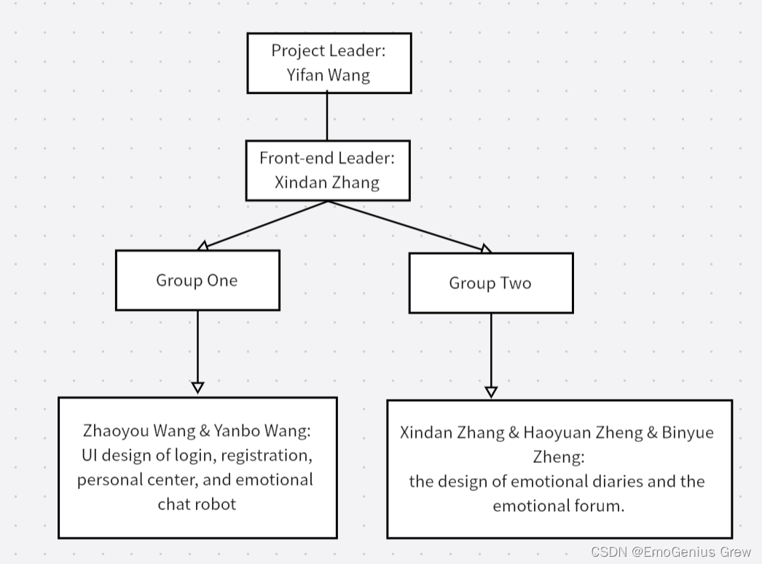

Slide 8
Objectives
Product Prospects
Challenges in Current Apps
Our Vision
Negative culture and misunderstandings prevail in existing
social apps due to a lack of emphasis on user emotions.
Introducing a revolutionary approach –
Integrating intelligent emotional robots
for a purer emotional sharing and
analysis experience.

Slide 9
Team organization method
Regularly assess team performance: Evaluate team performance periodically, identify problems, and take timely measures for improvement. Regular performance assessments help the team identify issues and make adjustments and improvements promptly
3
Team meetings: In order to better coordinate the work among all members, we will hold a meeting every day, in which we will explain their progress and give the next schedule.
Communication: Our group communicates and collaborates through offline communication and online voice communication. All members are serious and responsible for their work and can complete the task in a short time.
Feedback: We will give feedback and improvement regularly, each member will put forward their own views on the work, and finally we will jointly decide on a best improvement plan.
Mutual Support and Encouragement: We place a high value on mutual support and encouragement among team members. When a team member encounters challenges, we make every effort to assist and motivate them.

Slide 10
03
Schedule arrangement
PART THREE

Slide 11
A well-structured schedule ensures that each task and milestone has a dedicated timeframe. It helps in utilizing time efficiently, avoiding last-minute rushes, and achieving the project's objectives within the stipulated time. The team leader reasonably arranges the work schedule to ensure that the work is completed in an orderly manner.
The primary objective of the front-end tasks this week is to finalize all interface designs for the application (subject to potential adjustments later). The designated timeframe for these tasks is from October 30 to November 10.
October 30:
The front-end team conducted an online meeting to conclude a draft version of the application interface prototype, subsequently forming two teams.
October 31:
The initial Tencent video conference was held to establish a unified UI design style, define the overall design layout, and outline the schedule.
October 31 to November 1:
The two teams worked independently to fulfill their respective tasks, maintaining online communication throughout the process.
November 2:
Completion of all application interfaces (first version), followed by the second Tencent video conference for collaborative modifications, improvements, and finalization of the team logo.
November 6 to November 8:
Composition of the Interface Prototype Design.
November 9 to November 10:
Compilation of the blog on CSDN and creation of the PPT.

Slide 12
04
Interface Prototype Design
PART FOUR

Slide 13

Interface Prototype Design
In the realm of UI design, our team extensively employs specialized prototype design tools to construct frameworks and efficiently leverage resources. The primary tools selected for this purpose are Instant Design and Mockplus. Additionally, we source relevant materials, including downloads from Iconfont, with a minor portion of fonts crafted using Blender modeling.

Slide 14
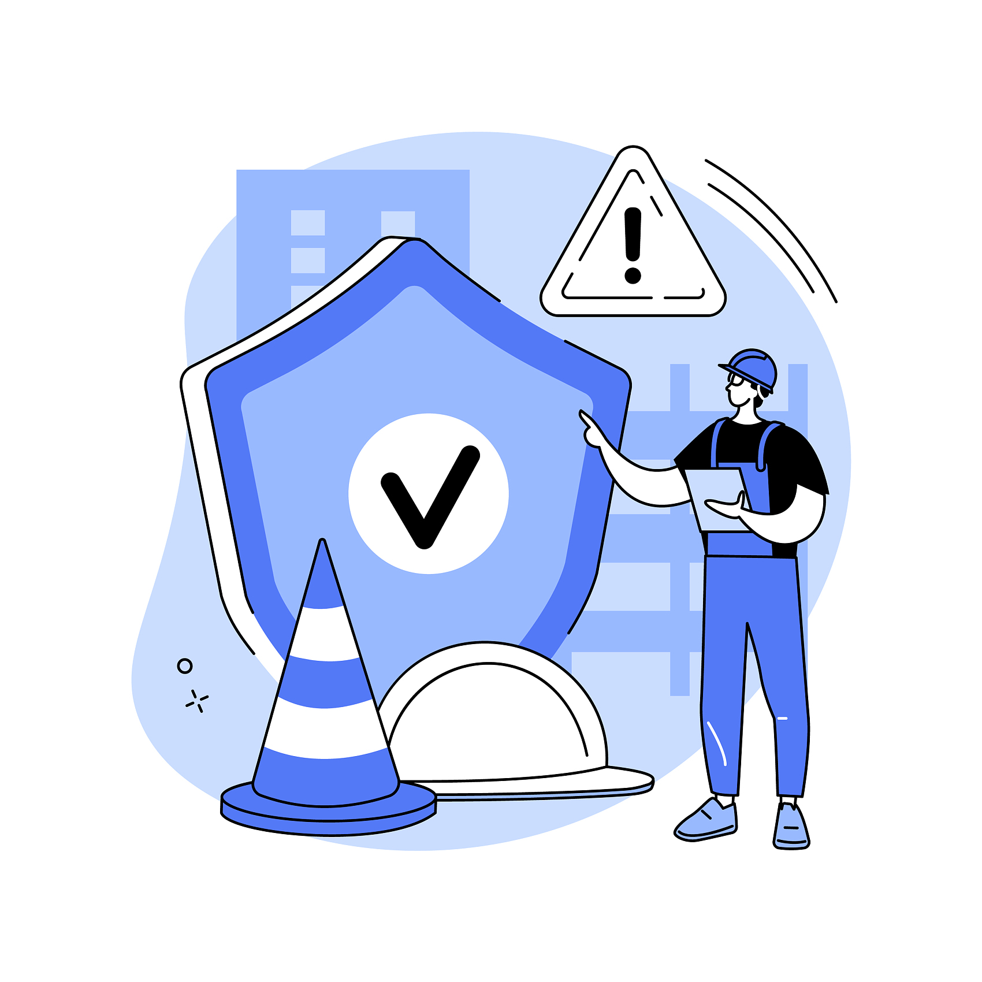
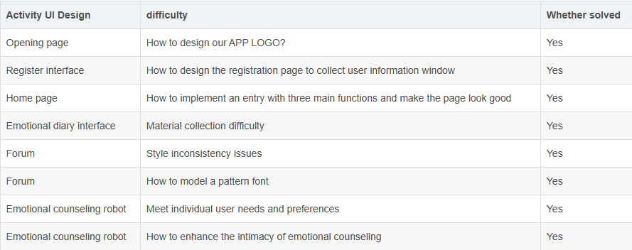
Prototype Design Process and Outcomes:
The subsequent sections will showcase the prototype design based on the distinct functional blocks outlined in the Software Requirements Specification. We will provide detailed insights into the main page, login/register page, pages corresponding to the three key functions, and the user center page. The exploration will unfold sequentially within each functional block, following the order of "results of prototype design - process of design (difficulties)."

Slide 15
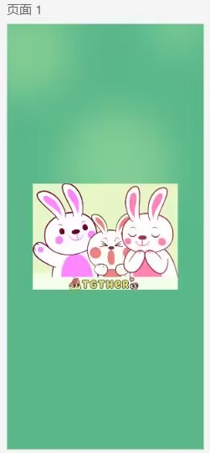
2.1.1 Results
This is the first page users encounter upon opening the software, and it will automatically disappear after displaying for 3 seconds, transitioning to the login interface. The cover showcases the product name and the creative team against a green background adorned with the product logo. This reflects our team's emphasis on user-friendliness during the design of this software, establishing a fresh, minimalist, and lively color scheme for the entire application.

Slide 16

2.1.2 Process
Solution Attempts and Whether Solved:
This difficulty has been successfully addressed. Although it was too late to modify the overall style of the software, including the main textures and components, our team collectively brainstormed during an online meeting. We proposed different design solutions, including a combination of patterns and the software name, using only the initial letters of the software name, and incorporating the initials of the software name and team name. Ultimately, we unanimously adopted the pattern and software name design solution.
2.2.3 What Was Gained:
Throughout the progression of the project, valuable lessons were learned. When encountering issues, it is essential to actively engage in discussions with relevant team members and leaders, listen to different opinions, and then advance the project. Additionally, referencing existing designs and learning from mature design concepts proved beneficial. When solutions were unclear, multiple attempts from various perspectives were made, actively employing the spiral model to unearth design inspiration and promptly make corrections.
Difficulty Description:
During the process of designing the software logo, our team encountered several challenges. Firstly, there was no dedicated member within the team for designing the software logo, and the primary cartoon pattern or image for the software was not determined in the early stages of the project. This resulted in the later creation of the software logo, where we had to refer back to the already completed pages and determine the elements to be used in the logo.

Slide 17
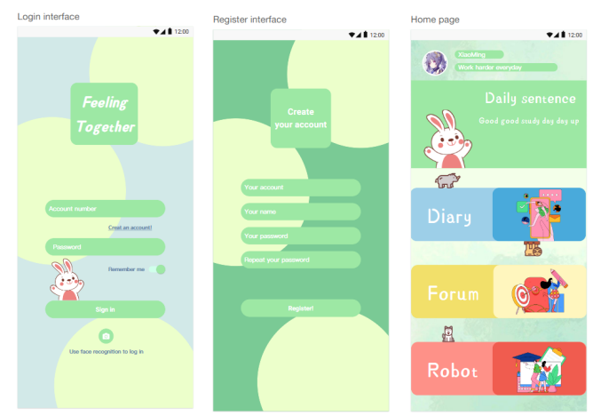
2.2.1 Results
Login/Register interface
Upon viewing the front-page interface, users are directed to the Login interface, prominently featuring the app's title. Users have the option to log in using their account credentials or facial recognition. For new users, there is an option to click on 'Create an account,' which leads them to the 'Register interface' page where they can establish an account password and provide additional required information.
Home page
Upon touching their profile picture, users can access the individual center. Additionally, users have the option to touch one of three buttons to enter distinct modules: diary, forum, and robot. Furthermore, users can view their username along with a sentence in the daily sentence module. The purpose of these positive sentences is to elicit improved emotions in users.

Slide 18

2.2.2 Process
Difficulty Description:
When designing the UI, the interface tends to become monotonous, empty, or overly complex, making it challenging to find a balanced and comfortable design structure.
What Was Gained:
Throughout the progression of the project, valuable lessons were learned. When encountering issues, it is essential to actively engage in discussions with relevant team members and leaders, listen to different opinions, and then advance the project. Additionally, referencing existing designs and learning from mature design concepts proved beneficial. When solutions were unclear, multiple attempts from various perspectives were made, actively employing the spiral model to unearth design inspiration and promptly make corrections.
Solution Attempts + Whether Solved:
Various design methods were discussed with team members, leading to the formulation of multiple design drafts. We took into account the aesthetic perceptions of as many team members as possible and iterated quickly on existing designs. In some interfaces, we referenced mature designs. Using design tools, we arranged elements such as controls neatly and aesthetically. Simultaneously, we enriched the pages by adding patterns from a material library that align with the overall design.

Slide 19
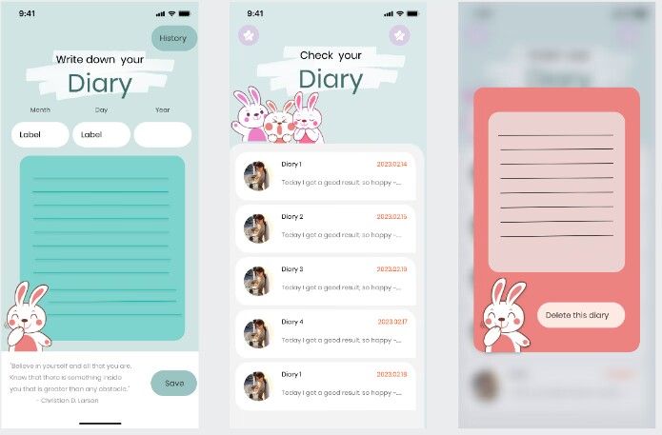
2.3.1 Emotional diary interface
2.3.1.1 Result
Our group plans to make the emotional diary module a separate interface, which can be entered after the "Emotional Diary" button on the homepage.
In this diary module, users can choose to create and save a new emotional diary or review the history by clicking one of the buttons at the very beginning page.

Slide 20



2.3.1.2 Process
Difficulty description:
Difficulties in finding material : including how to find the right pattern and background.
1.We need to determine what kind of patterns to look for can meet the overall design of the APP, and whether different styles of patterns are needed in different modules and how many patterns to look for.
2.The need to determine the source of the pattern prototype, that is : in what website can find the right pattern prototype.
3.Copyright and compliance issues

Slide 21

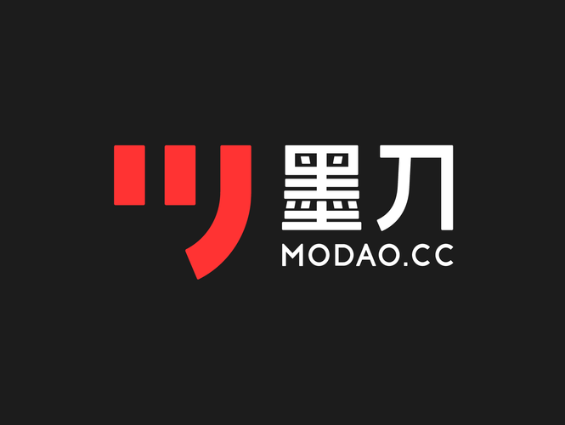


2.3.1.2 Process
Solution attempts and Whether solved:
1.Our group held an online meeting separately at the beginning of the project, and each member expressed his views and decided the most appropriate plan. Finally, we decided to find some lovely rabbit patterns.
2.According to the results of the above meeting, everyone went to find several sets of materials and shared them. Finally, it was determined that our pattern prototype mainly came from ink knife, instant design and Xiaohongshu materials.
3. In order to ensure that the selected material does not infringe any copyright or intellectual property rights, so as not to cause legal problems. We carefully review the copyright of each material before use, and avoid using resources that clearly mark ' uncommercial '.

Slide 22
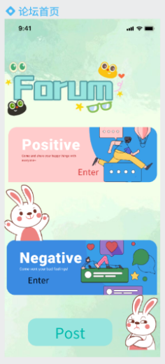
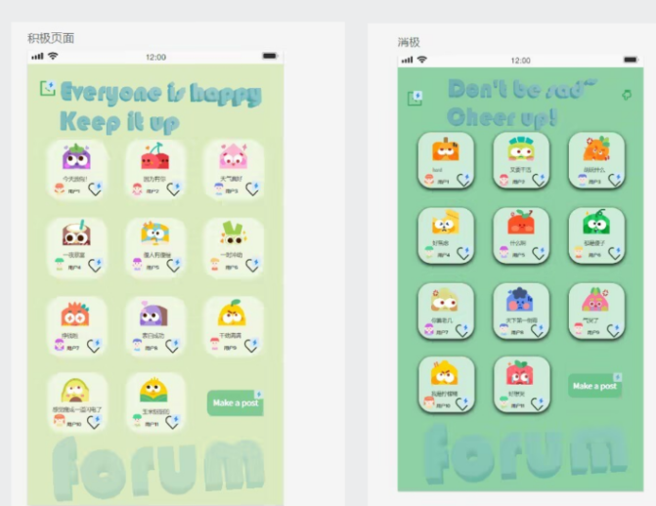
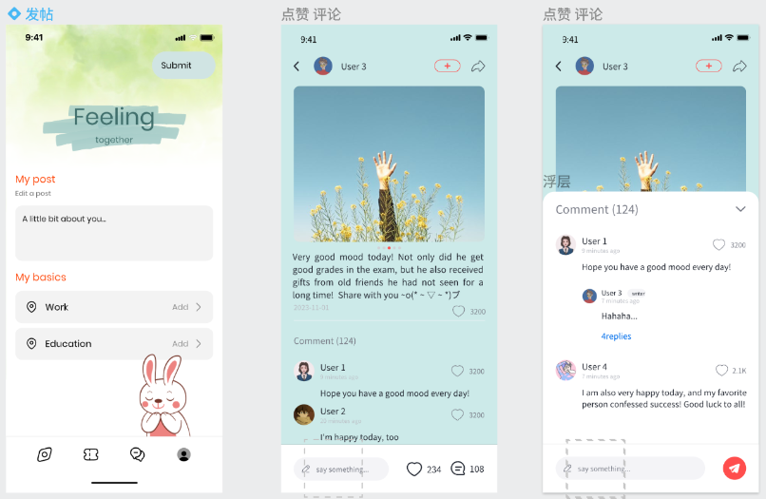
2.3.2 Forum
2.3.2.1 Result
Our group plans to divide the forum into 4 interfaces, namely: main interface, specific partition interface, posting interface, likes, comments, and reply interfaces for each post.

Slide 23

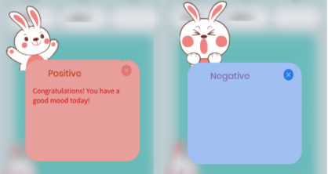
2.3.2.2 Process
Difficulty description:
1.How to choose a main framework that can adapt to the remaining functions and conform to the function. Because this part of the UI design volume is the largest, so this part of the design style, framework, etc.on the overall UI effect has a negligible impact ( forum home page design, for example ).
2.Font design and click effect of positive and negative pages. We have tried to use the font that can be modified in the ink knife, but the effect is not ideal. Our group hopes that these two partitions in the emotional forum can have a prominent sense of design.

Slide 24


2.3.2.2 Process
Solution attempts and Whether solved:
1.Through the red book search, the green tie-dye background that meets the theme is first determined, and then the art words and two maps corresponding to the entrance of positive and negative emotions are added. With cute and vivid rabbit, add a sense of lively.
2.The font part is modeled using blender software, and the head-up and ' forum ' words are designed through an online search tutorial. Add ' add component status ' to the page, so that the like function in the lower right corner of each mood realizes the function of clicking once ( single click ) as a like and then clicking ( double click ) as a cancellation.

Slide 25
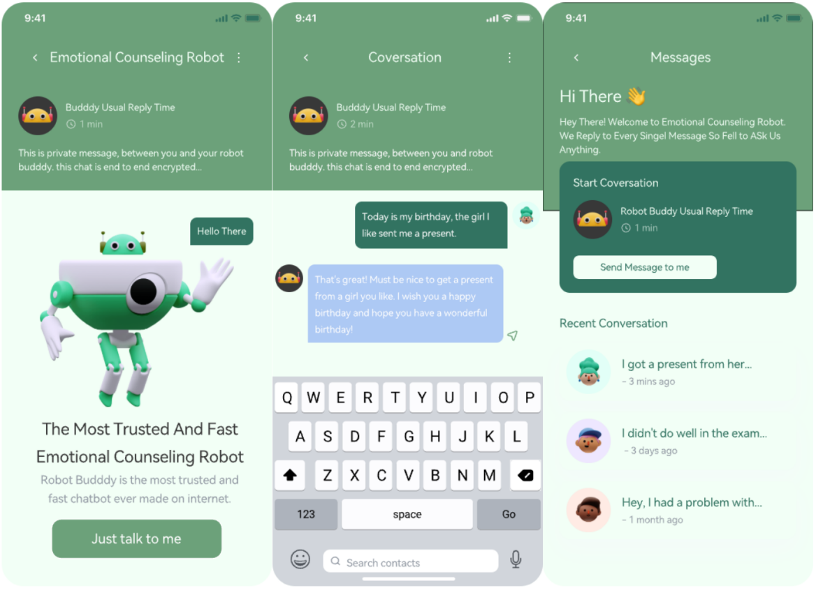
2.3.3 Emotional counseling robot
2.3.3.1 Result
The function of emotional counseling robot is divided into two interfaces: main interface and conversation interface.
The main interface consists of: emotional counseling robot function introduction, emotional counseling robot cartoon image display and chat start button (Just talk to me).
In the conversation page, users can click the text input field at the bottom to enter text to talk with the robot buddy, or click the voice recognition button at the lower right corner to convert the user's voice into text information.

Slide 26




2.4.1 Result
2.4.1.1 Individual center
Individual center has four functions: checking the numbers of follows and followers, looking the browsing history, looking user’s all diary and comments, and setting personal information.

Slide 27
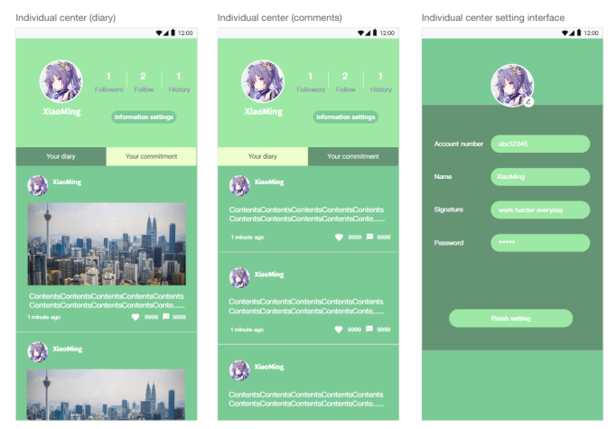
2.4.1.2 Individual center setting interface
Individual center setting interface provides the function of modifying user information. A user can change profile pictures, account number, name signature and password. These changes would be saved when the user presses' Finish setting '.

Slide 28




2.4.2 process
Difficulty description:
When designing the three pages of login, registration ( 2.2 ) and personal information setting, it is necessary to avoid homogenization, which makes it difficult for users to distinguish the situation of each page.
Solution attempts and Whether solved:
Solution attempts and Whether solved:
Through different design styles, typesetting, background color distinction, and text prompts, users can clearly identify different pages.

Slide 29
05
Analysis of possible key points and challenges
PART FIVE

Slide 30

Prototype Design Process and Outcomes:
1. Late Logo Design: The challenge of designing the software logo late in the project, leading to difficulties aligning it with the overall style and components of the software.
2.UI Design Monotony: Avoiding the homogeneity of UI designs for login, registration, and personal information setting pages to prevent confusion among users.
3.Material Search Difficulty: Challenges related to finding suitable patterns and backgrounds, including determining the style alignment, quantity, and source of pattern prototypes.

Slide 31
Prototype Design Process and Outcomes:
4.Font and Click Effects Design: Designing fonts and click effects on positive and negative pages in the emotional forum may pose challenges in achieving a desired sense of design.
5.Effective Division of Forum Interfaces: Successfully dividing the forum into four interfaces, including main, partition, posting, and interaction interfaces, while maintaining a coherent design.
6.User Interface Consistency: Maintaining a consistent and visually appealing user interface across different modules and functions poses a potential challenge.

Slide 32
Possible key points
4.Utilization of Prototype Design Tools: The team utilizes specialized prototype design tools such as Instant Design and Mockplus for constructing frameworks and leveraging resources.
5.Material Sourcing: The sourcing of materials, including patterns and backgrounds from platforms like Iconfont, is a key aspect of UI design.
6.Schedule Arrangement: A well-structured schedule is essential for ensuring each task and milestone has a dedicated timeframe, promoting efficient time utilization.
7.Division of Forum Interfaces: Segmentation of the forum into four interfaces poses both a key point and potential challenge, emphasizing the need for a balanced and effective design.
Collaborative Grouping Approach: The adoption of a collaborative grouping approach is a key strategy, promoting efficient task completion by dividing the team into specialized groups (frontend, backend, server, and documentation).
Regular Work Exchange Meetings: Holding regular meetings is crucial for maintaining communication, coordination, and task integrity among team members.
Performance Assessment: Periodic assessments of team performance allow for the identification of issues, enabling timely measures for improvement.

Slide 33
06
Feelings and Evaluations of Teammates
PART SIX

Slide 34
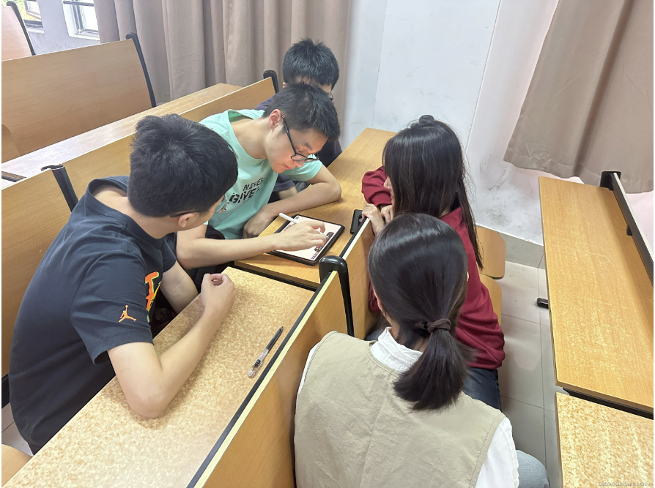
Our team's spirit of collaboration is evident in our close cooperation and harmonious relationships. In this project, each team member demonstrated a high level of responsibility and teamwork.

Slide 35
Through this project, we not only achieved our set objectives but also built a strong foundation for future teamwork. This experience has laid the groundwork for continued successful collaboration in future endeavors.
Team Collaboration Spirit
High Sense of Responsibility
Our team's collaborative spirit is reflected in proactive communication and mutual support. Throughout the project cycle, we maintained timely and efficient communication through various means, including online discussions, video conferences, and offline meetings. Everyone shared a strong sense of common goals, enabling us to quickly address issues and adjust directions, ensuring the smooth progress of the project.
Each team member demonstrated a high sense of responsibility. Everyone took ownership of their tasks, completed work on time, and was willing to exert effort for the team's goals. This high level of responsibility was a crucial factor in our team's success in the project.
Harmonious Relationships
The team members have established harmonious relationships, contributing to better collaboration. Everyone willingly shared experiences and knowledge, actively providing assistance. Faced with challenges, we worked together and supported each other, creating a positive and uplifting atmosphere within the entire team.

Slide 36
Thank You
Software Engineering

